Slide 1
Platforms to handle Big data
Dr. Jigna Ashish Patel
Assistant Professor, CSE Dept,
Institute of Technology,
Nirma University

Slide 2
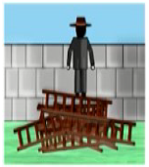
Objective of the lecture
Right platform
Need of the application/algorithm
Right decision

Slide 3
How quickly do we need to get the results?
How big is the data to be processed?
Does the model building require several iterations or single iteration?

Slide 4
System/platform level requirements
Will there be a need for more data processing capability in the future?
Is the rate of data transfer critical for this application?
Is there a need for handling hardware failures within the application?

Slide 5
Horizontal Scaling
It involves distributing the workload across many servers which may be even commodity machines.
It is also known as “scale out”, where multiple independent machines are added together in order to improve the processing capability.
Typically, multiple instances of the operating system are running on separate machines.

Slide 6
Vertical Scaling
Vertical Scaling involves installing more processors, more memory and faster hardware, typically, within a single server.
It is also known as “scale up” and it usually involves a single instance of an operating system.

Slide 7
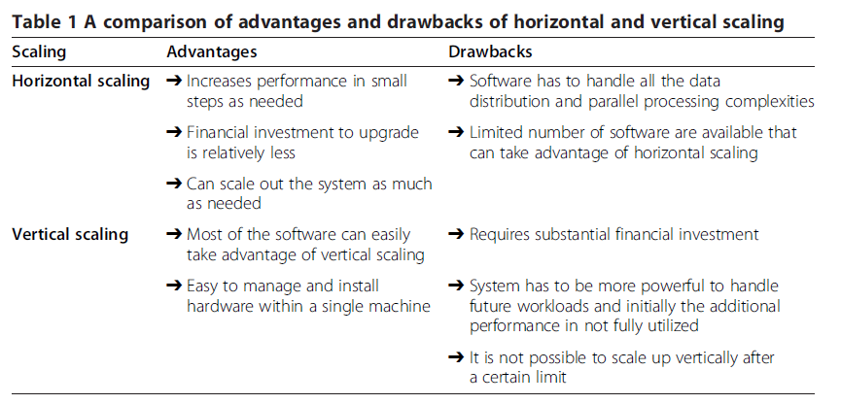

Slide 8
Horizontal Scaling Platforms
Peer-to-Peer Network
Apache Hadoop
Apache Spark
Vertical Scaling Platforms
High performance computing clusters
Multicore CPU
Graphics Processing Unit(GPU)
Field Programmable gate arrays(FPGA)

Slide 9
Peer-to-Peer networks
involve millions of machines connected in a network
decentralized and distributed network architecture where the nodes in the networks (known as peers) serve as well as consume resources.
oldest distributed computing platforms
Message Passing Interface (MPI) for communication scheme used in such a setup to communicate and exchange the data between peers.
Each node can store the data instances and the scale out is practically unlimited (can be millions of nodes).

Slide 10
Apache Hadoop
open source framework for storing and processing large datasets using clusters of commodity hardware.
Hadoop is designed to scale up to hundreds
highly fault tolerant
The Hadoop platform contains the following two important components: (1) HDFS (2) YARN

Slide 11
Apache Spark
developed by researchers at the University of California at Berkeley. designed to overcome the disk I/O limitations
ability to perform in-memory computations.
allows the data to be cached in memory, thus eliminating the
Hadoop’s disk overhead limitation for iterative tasks.
supports Java, Scala and Python and for certain tasks
it is tested to be up to 100× faster than Hadoop MapReduce

Slide 12
HPC clusters
Known as blades or supercomputers, are machines with thousands of cores.
They can have a different variety of disk organization, cache, communication mechanism etc.
powerful hardware which is optimized for speed and throughput.
They are not as scalable as Hadoop or Spark clusters but they are still capable of processing terabytes of data.

Slide 13
Multicore CPU
Multicore refers to one machine having dozens of processing cores They usually have shared memory but only one disk.
the number of cores per chip and the number of
operations that a core can perform has increased significantly. Newer breeds of motherboards allow multiple CPUs within a single machine thereby increasing the parallelism.
Until the last few years, CPUs were mainly responsible for accelerating the algorithms for big data analytics.

Slide 14
GPU
It is designed to accelerate the creation of images in a frame buffer intended for display output
GPUs were primarily used for graphical operations such as video and image editing, accelerating graphics-related processing etc. due to their massively parallel architecture, recent developments in GPU hardware and related programming frameworks have given rise to GPGPU
In addition to the processing cores, GPU has its own high throughput DDR5 memory which is many times faster than a typical DDR3 memory.

Slide 15
FPGA
highly specialized hardware units for specific applications
FPGAs can be highly optimized for speed and can be orders of magnitude faster compared to other platforms for certain applications.
Due to customized hardware, the development cost is typically much higher compared to other platforms.
On the software side, coding has to be done in HDL with a low-level knowledge of the hardware which increases the algorithm development cost.

Slide 16
Comparison of platforms
System/Platform Level characteristics
Scalability
Data I/O performance
Fault Tolerance

Slide 17
Scalability
Platform | Scalability
Peer-to-Peer | * * * * *
Virtual Clusters(MapReduce/MPI) | * * * * *
Virtual Clusters(Spark) | * * * * *
HPC clusters (MPI/MapReduce) | * * *
Multicore(Multithreading) | * *
GPU(CUDA) | * *
FPGA(HDL) | *

Slide 18
Data I/O Performance
Platform | Data I/O performance
Peer-to-Peer | *
Virtual Clusters(MapReduce/MPI) | * *
Virtual Clusters(Spark) | * * *
HPC clusters (MPI/MapReduce) | * * * *
Multicore(Multithreading) | * * * *
GPU(CUDA) | * * * * *
FPGA(HDL) | * * * * *

Slide 19
Fault Tolerance
Platform | Fault Tolerance
Peer-to-Peer | *
Virtual Clusters(MapReduce/MPI) | * * * * *
Virtual Clusters(Spark) | * * * * *
HPC clusters (MPI/MapReduce) | * * * *
Multicore(Multithreading) | * * * *
GPU(CUDA) | * * * *
FPGA(HDL) | * * * *

Slide 20
Comparison of platforms
Application/Algorithm Level characteristics
Real time processing
Data size supported
Iterative task support

Slide 21
Real Time Processing
Platform | Real Time Processing
Peer-to-Peer | *
Virtual Clusters(MapReduce/MPI) | * *
Virtual Clusters(Spark) | * *
HPC clusters (MPI/MapReduce) | * * *
Multicore(Multithreading) | * * *
GPU(CUDA) | * * * * *
FPGA(HDL) | * * * * *

Slide 22
Data Size supported
Platform | Data Size supported
Peer-to-Peer | * * * * *
Virtual Clusters(MapReduce/MPI) | * * * *
Virtual Clusters(Spark) | * * * *
HPC clusters (MPI/MapReduce) | * * * *
Multicore(Multithreading) | * *
GPU(CUDA) | * *
FPGA(HDL) | * *

Slide 23
Iterative Task Support
Platform | Iterative task support
Peer-to-Peer | * *
Virtual Clusters(MapReduce/MPI) | * *
Virtual Clusters(Spark) | * * *
HPC clusters (MPI/MapReduce) | * * * *
Multicore(Multithreading) | * * * *
GPU(CUDA) | * * * *
FPGA(HDL) | * * * *

Slide 24
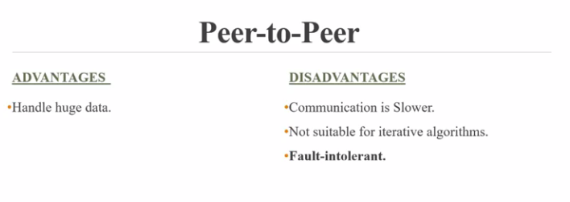
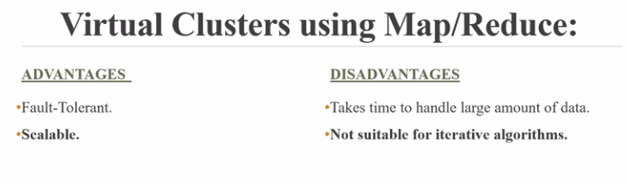

Slide 25
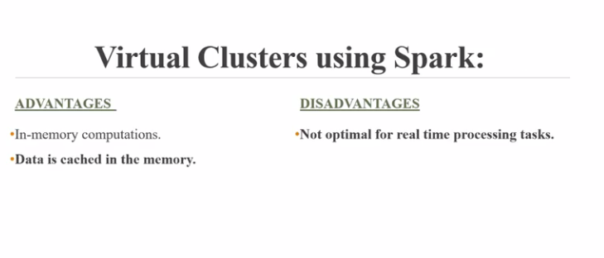
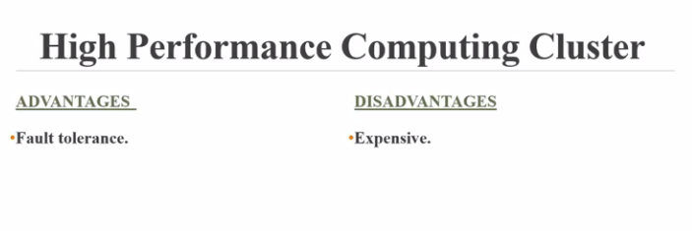

Slide 26
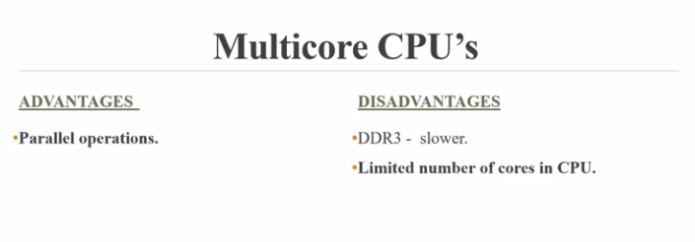
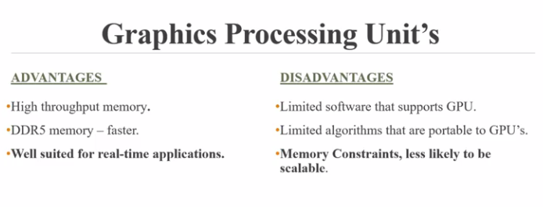

Slide 27
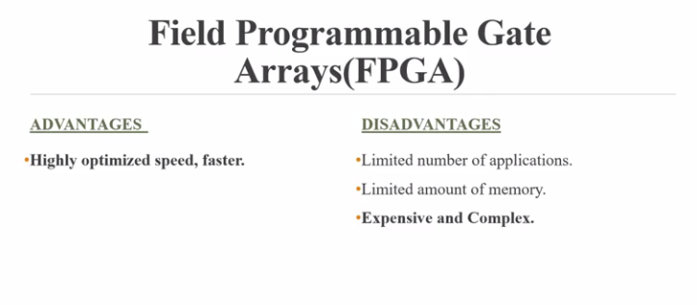

Slide 28
How will you choose one of platform for a particular criteria ?

Slide 29
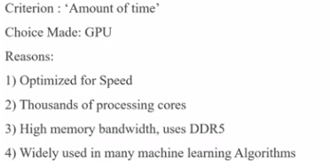
Amount of Time

Slide 30
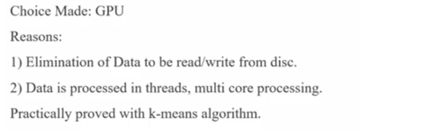
Number of Iterations

Slide 31
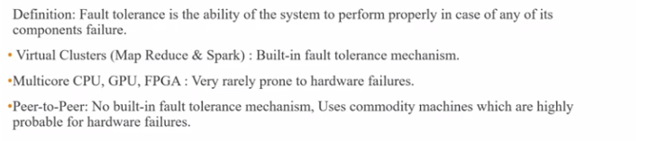
Fault Tolerance

Slide 32
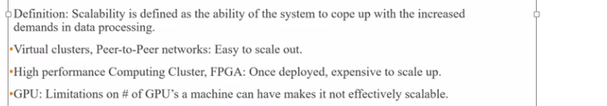
Scalability

Slide 33
Choice of platform
Data size
Speed/Throughput
Training /Applying a model

Slide 34
K means clustering

Slide 35
K-means on MapReduce

Slide 36
K-means on MPI

Slide 37
K-means on GPU

